Slide 1
Locating a New Indian Restaurant in Mumbai
- Pratap Balakrishnan

Slide 2
Introduction / Problem Definition
Mumbai has 24 wards
To identify a ward that is best suited to open a new Indian restaurant in Mumbai
Criteria: The area should already be popular for having Indian restaurants but Indian restaurants should not be the most popular venue

Slide 3
Data
Mumbai ward geometry from https://github.com/datameet/Municipal_Spatial_Data/blob/master/Mumbai/BMC_Wards.geojson
Mumbai ward names from http://www.demographia.com/db-mumbaidistr91.htm

Slide 4
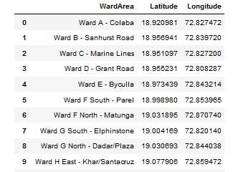
… Data
Create Data Frame combining the two

Slide 5
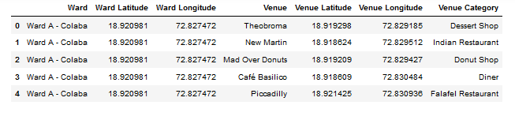
… Data
Get venues for each ward from Four Square API

Slide 6
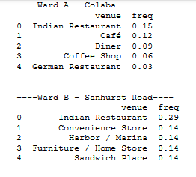
Explore and Process Data
Get the fequency of occurrence of venues for each ward

Slide 7
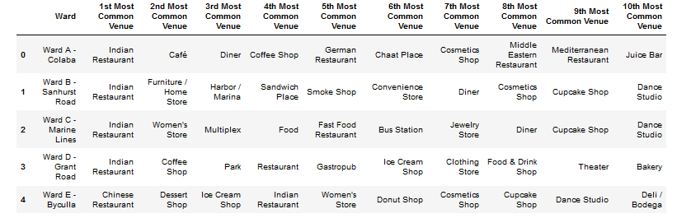
... Explore and Process Data
Get top 10 venues by ward

Slide 8
Clustering
Clustering using Kmeans
Find optimum number of clusters by elbow method
The 1st cycle with number of clusters = 5, we get one big group and the other 4 clusters which can be ignored as not of interest for opening an Indian restaurant
Re-cluster the one big group this time with number of clusters = 6

Slide 9
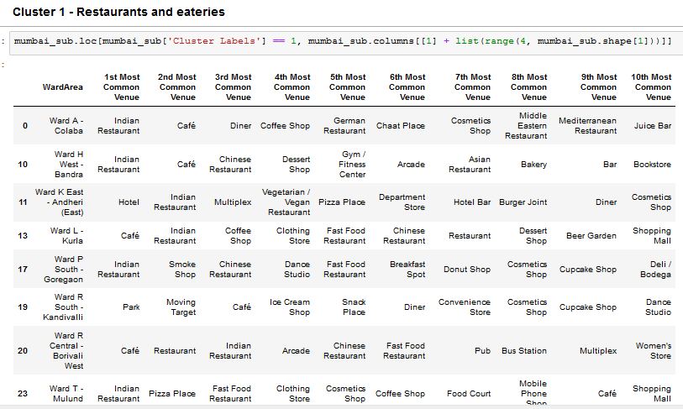
Results
Of the 6 clusters following cluster best meets our criteria

Slide 10
Discussion
From this cluster the following areas can be considered
Ward K East – Andheri East – where Indian restaurant was the 2nd most popular
Ward L – Kurla – where Indian restaurant was the 2nd most popular
Ward R Central – Borivali West – where Indian restaurant was the 3rd most popular

Slide 11
… Discussion
Based on this it is recommended to open a new Indian restaurant in Borivali West
As a secondary alternative Andheri East / Kurla in this cluster could be considered

Slide 12
Conclusion
A analysis of Mumbai Wards was done
Venues for each ward within 500m of the center of ward was obtained using Four Square API
Based on clustering it is recommended that the best place to open a new Indian restaurant is Borivali West
Alternative locations are Andheri East and Kurla

